Slide 1
Data Communications

Slide 2
DIGITAL DATA, ANALOG SIGNALS
Digital-to-analog conversion is the process of changing one of the characteristics of an analog signal based on the information in digital data.
.

Slide 3
DIGITAL DATA, ANALOG SIGNALS
Transmitting digital data through the public telephone network.
Telephone network was designed to receive, switch, and transmit analog signals in the voice-frequency range of about 300 to 3400 Hz.
Digital devices are attached to the network via a modem (modulator-demodulator), which converts digital data to analog signals, and vice versa
.

Slide 4
DIGITAL DATA, ANALOG SIGNALS
An analog signal carries 4 bits per signal element. If 1000 signal elements are sent per second, find the bit rate.
4000bps
.

Slide 5
DIGITAL DATA, ANALOG SIGNALS
An analog signal has a bit rate of 8000 bps and a baud rate of 1000 baud.
How many data elements are carried by each signal element?
How many signal elements do we need?
.

Slide 6
DIGITAL DATA, ANALOG SIGNALS
An analog signal has a bit rate of 8000 bps and a baud rate of 1000 baud.
How many data elements are carried by each signal element?
How many signal elements do we need?
Data elements = 8bit
Number of different Signal elements required : 256
.

Slide 7
DIGITAL DATA, ANALOG SIGNALS
Carrier Signal (Modulated signal) : High-frequency signal.
Message signal (Modulating signal) :
.

Slide 8
DIGITAL DATA, ANALOG SIGNALS
Digital information changes the carrier signal by modifying one or more of its characteristics (amplitude, frequency, or phase).
This kind of modification is called modulation (shift keying)
Modulation techniques :
Amplitude shift keying (ASK),
Frequency shift keying (FSK),
Phase shift keying (PSK).
Quadrature Amplitude Modulation (QAM)
.

Slide 9
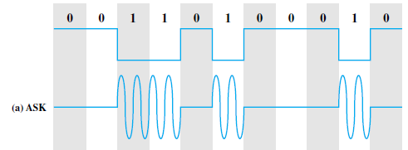
Amplitude Shift Keying
In amplitude shift keying, the amplitude of the carrier signal is varied to create signal elements.
Both frequency and phase remain constant while the amplitude changes.
Binary Amplitude Shift Keying
The peak amplitude of one signal level is 0; the other is the same as the amplitude of the carrier frequency
.

Slide 10
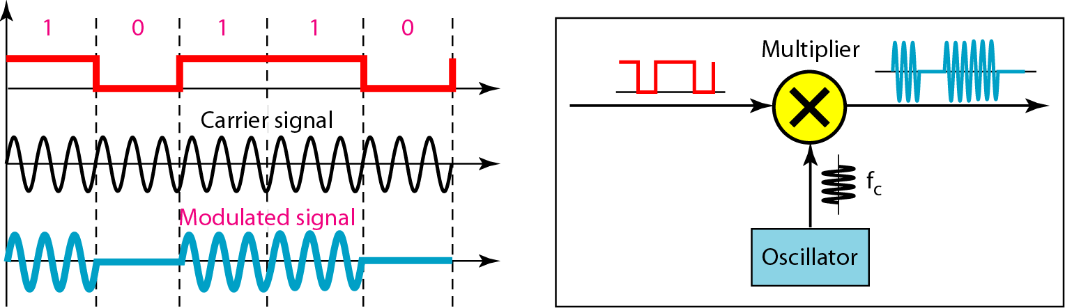

Amplitude Shift Keying
When the amplitude of the NRZ signal is 1, the amplitude of the carrier frequency is held;
when the amplitude of the NRZ signal is 0, the amplitude of the carrier frequency is zero
The resulting transmitted signal is
where the carrier signal is
.

Slide 11
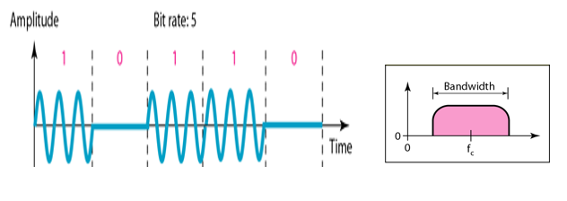
Amplitude Shift Keying
.

Slide 12
Amplitude Shift Keying
The ASK technique is used to transmit digital data over optical fiber.
For LED transmitters, one signal element is represented by a light pulse while the other signal element is represented by the absence of light.
For Laser transmitters, low level represents one signal element, while a higher-amplitude light wave represents another signal element.
.

Slide 13
Amplitude Shift Keying
Given a bandwidth of 10,000 Hz (1000 to 11,000 Hz), draw the full-duplex ASK diagram of the system.
Find the carriers and the bandwidths in each direction. Assume there is no gap between the bands in the two directions.
.

Slide 14
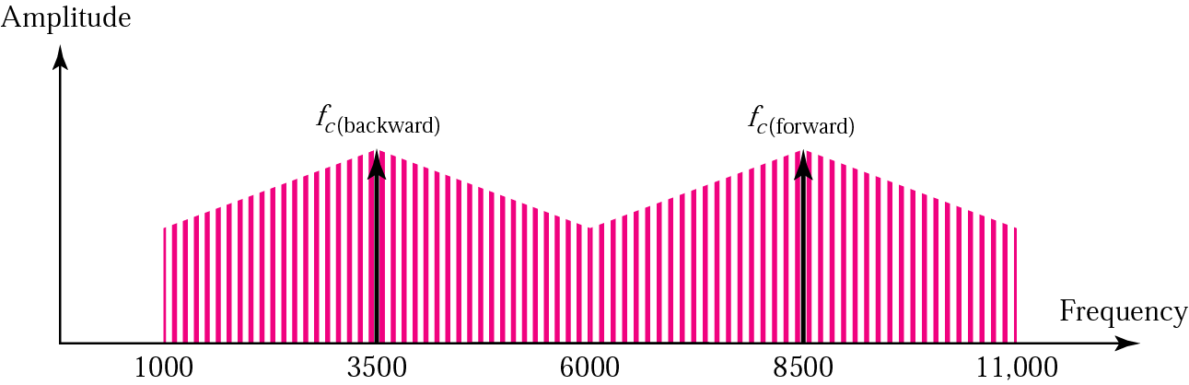
Amplitude Shift Keying
For full-duplex ASK, the bandwidth for each direction is
BW = 10000 / 2 = 5000 Hz
The carrier frequencies can be chosen at the middle of each band
fc (backward) = 1000 + 5000/2 = 3500 Hz
fc (forward) = 11000 – 5000/2 = 8500 Hz
.

Slide 15
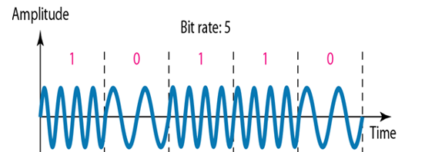
Frequency Shift Keying
In frequency shift keying, the frequency of the carrier signal is varied to represent data.
The frequency of the modulated signal is constant for the duration of one signal element, but changes for the next signal element if the data element changes.
Both peak amplitude and phase remain constant for all signal elements.
The most common form of FSK is binary FSK (BFSK), in which the two binary values are represented by two different frequencies.
.

Slide 16

Frequency Shift Keying
The resulting transmitted signal for one bit time is
where f₁ and f₂ are typically offset from the carrier frequency f_{c} by equal but opposite amounts.
BFSK is less susceptible to error than ASK.
Telephone lines.
It is also commonly used for high-frequency (3 to 30 MHz) radio transmission.
.

Slide 17
Multiple FSK (MFSK)
More than two frequencies (M frequencies) are used
.

Slide 18
Multiple FSK (MFSK)
Period of signal element
Minimum frequency separation
MFSK signal bandwidth:
.

Slide 19
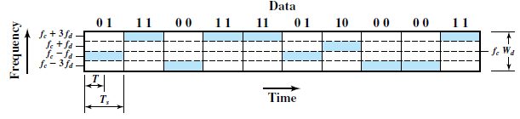
Multiple Frequency Shift Keying
.

Slide 20
Multiple FSK (MFSK)
For f_{c}=250KHz, f_{d}=25KHz, and M=8 (L=3 bits), find
The frequency assignment for each of the 8 possible 3-bit data combinations.
Bandwidth
Datarate
Solution :
.

Slide 21
Multiple FSK (MFSK)
With f_{c}=250KHz, f_{d}=25KHz, and M=8 (L=3 bits), what are the frequency assignment for each of the 8 possible 3-bit data combinations:
This scheme can support a data rate of:
.

Slide 22
We need to send data 3 bits at a time at a bit rate of 3 Mbps. The carrier frequency is 10 MHz. Calculate the number of levels (different frequencies), the baud rate, and the bandwidth.
Also find different frequencies.
.

Slide 23
We need to send data 3 bits at a time at a bit rate of 3 Mbps. The carrier frequency is 10 MHz. Calculate the number of levels (different frequencies), the baud rate, and the bandwidth.
Also find different frequencies
We can have L=3,M = 2³ = 8.
The baud rate is D=R/L
D= 3 Mbps/3 = 1 Mbaud.
The bandwidth is :
T=Bit period=1/3 micro sec
T_{S}=LT_{b}=3*(1/3) =1 micro sec
2fd=1/T_{S} =1MHz
Bandwidth=2Mfd= 8MHz
.

Slide 24
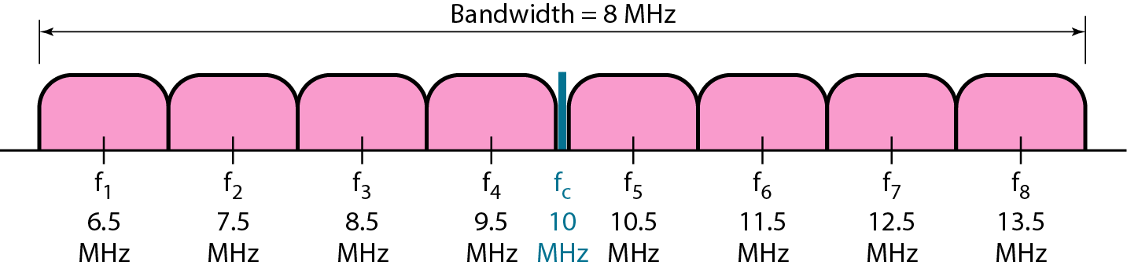
.

Slide 25

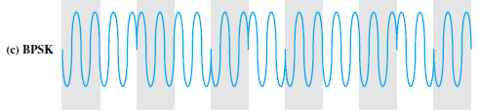
Phase Shift Keying
The phase of the carrier signal is shifted to represent data.
Two-Level PSK : Uses two phases to represent the two binary digits and is known as binary phase shift keying.
Phase of the carrier is varied to represent digital data (binary 0 or 1)
Amplitude and frequency remains constant.
If phase 0 deg to represent 0, 180 deg to represent 1. (2-PSK)
.

Slide 26

Phase Shift Keying
The resulting transmitted signal is
Because a phase shift of 180° is equivalent to flipping the wave or multiplying it by -1.
.

Slide 27
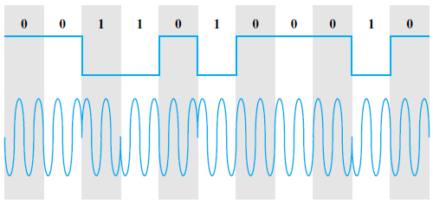
Differential PSK (DPSK)
In DPSK, the phase shift is with reference to the previous bit transmitted rather than to some constant reference signal
Binary 0:signal burst with the same phase as the previous one
Binary 1:signal burst of opposite phase to the preceding one
.

Slide 28
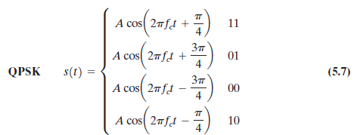
Phase Shift Keying
Four-Level PSK
More efficient use of bandwidth can be achieved if each signaling element represents more than one bit.
Quadrature phase shift keying (QPSK), uses phase shifts separated by multiples of
Each signal element represents two bits rather than one.
.

Slide 29
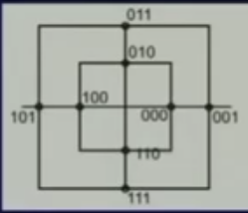
Quadrature Amplitude Modulation
PSK is limited by the ability of the equipment to distinguish small differences in phase.
This factor limits its potential bit rate.
By combining ASK and PSK it is possible to obtain higher data rate.
Quadrature amplitude modulation is a combination of ASK and PSK.
.

Slide 30



Performance
The transmission bandwidth
r depends on modulation and filtering process.
0<= r <=1
R is bit rate
M is number of different signal element.
L is number of bits
.

Slide 31
Multiplexing

Slide 32
Multiplexing
The communication media usually have much higher bandwidth.
On the other hand individual users have lesser data to send.
The two communicating stations do not utilize the full capacity of a data link.
Multiplexing is the set of techniques that allow the simultaneous transmission of multiple signals across a single data link.
Allows several transmission sources to share a larger transmission capacity.
.

Slide 33
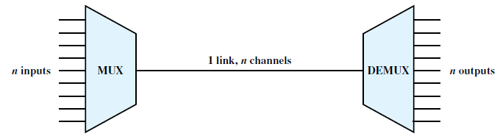
Figure 8.1 Multiplexing
Multiplexer : Combines (multiplexes) data from the n input lines and transmits over a higher-capacity data link.
Demultiplexer : Accepts the multiplexed data stream, separates (demultiplexes) the data according to channel, and delivers data to the appropriate output lines.
.

Slide 34
Three types of multiplexing techniques.
Frequency division multiplexing (FDM)
The most heavily used
Familiar to anyone who has ever used a radio or television set.
Time division multiplexing (TDM)
known as synchronous TDM.
Commonly used for multiplexing digitized voice streams and data streams.
Statistical TDM.
To improve on the efficiency of synchronous TDM by adding complexity to the multiplexer.
Also known as asynchronous TDM, and intelligent TDM.
.

Slide 35
FREQUENCY DIVISION MULTIPLEXING (FDM)
used with analog signals.
A number of signals are carried simultaneously on the same medium by allocating to each signal a different frequency band.
Modulation equipment is needed to move each signal to the required frequency band, and
Multiplexing equipment is needed to combine the modulated signals.
FDM is possible when the useful bandwidth of the transmission medium exceeds the required bandwidth of signals to be transmitted.
.

Slide 36
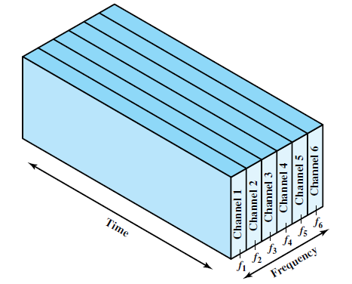
FREQUENCY DIVISION MULTIPLEXING (FDM)
(a) Frequency division multiplexing
A number of signals can be carried simultaneously if each signal is modulated onto a different carrier frequency and the carrier frequencies are sufficiently separated that the bandwidths of the signals do not significantly overlap.
.

Slide 37
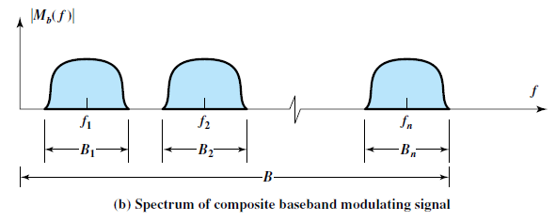
FREQUENCY DIVISION MULTIPLEXING (FDM)
Figure 8.4 FDM System
The spectrum of signal m_{i}(t) is shifted to be centered on f_{i}
f_{i} must be chosen so that the bandwidths of the various signals do not significantly overlap.
.

Slide 38
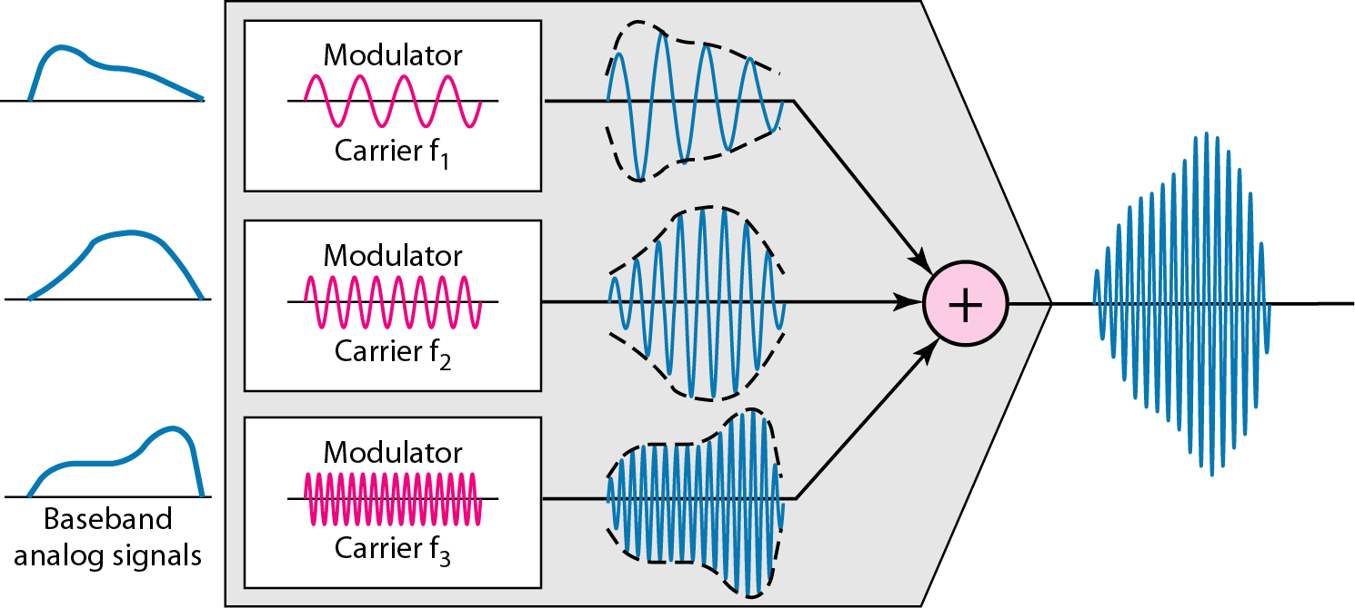
Multiplexing Process
Each source generates a signal of a similar frequency range.
Inside the multiplexer, these similar signals modulate different carrier frequencies ( f1, f2, and f3).
The resulting modulated signals are then combined into a single composite signal that is sent out over a media link.
.

Slide 39
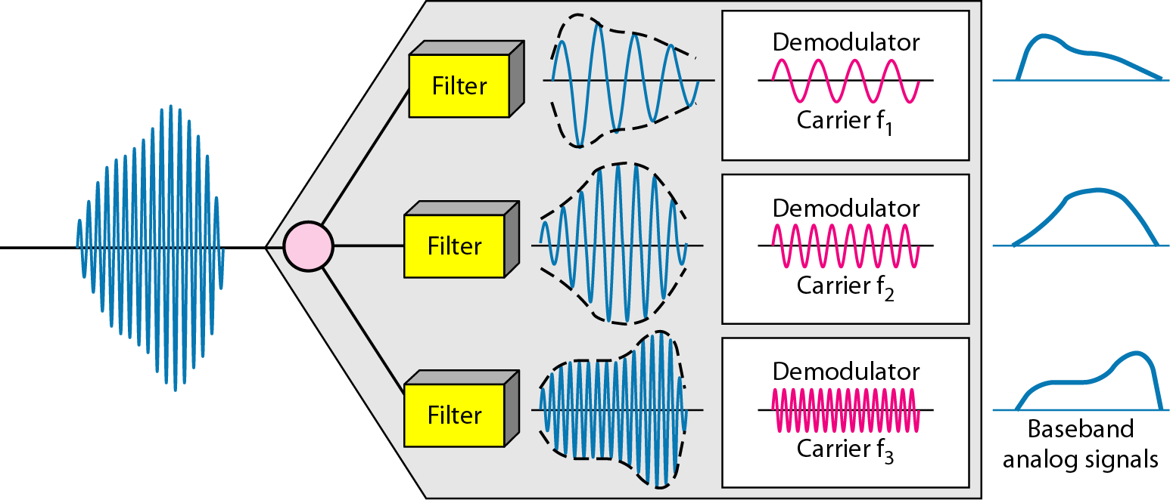
Demultiplexing Process
The demultiplexer uses a series of filters to decompose the multiplexed signal into its constituent component signals.
The individual signals are then passed to a demodulator that separates them from their carriers and passes them to the output lines.
.

Slide 40
Assume that a voice channel occupies a bandwidth of 4 kHz. We need to combine three voice channels into a link with a bandwidth of 12 kHz, from 20 to 32 kHz. Show the configuration, using the frequency domain. Assume there are no guard bands.
Solution
modulate each of the three voice channels to a different bandwidth.
Use the 20- to 24-kHz bandwidth for the first channel, the 24- to 28-kHz bandwidth for the second channel, and the 28- to 32-kHz bandwidth for the third one. Then we combine them .
.

Slide 41
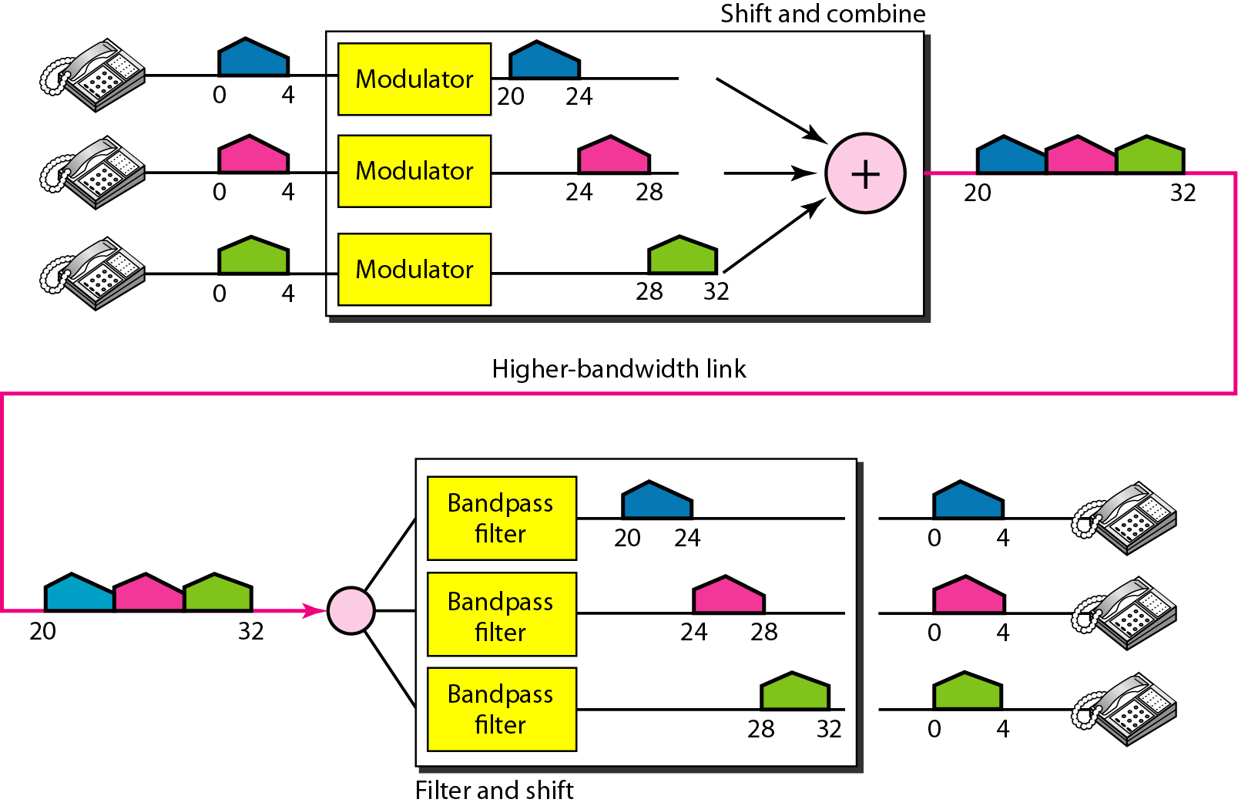
.

Slide 42
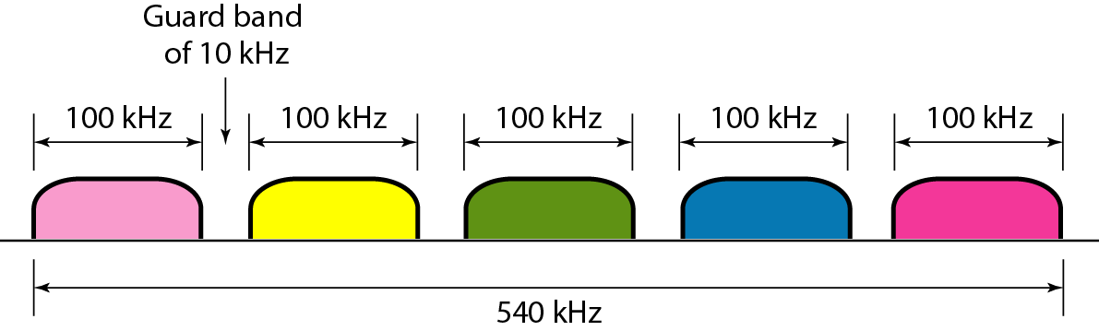
Five channels, each with a 100-kHz bandwidth, are to be multiplexed together. What is the minimum bandwidth of the link if there is a need for a guard band of 10 kHz between the channels to prevent interference?
Solution
For five channels, we need at least four guard bands. This means that the required bandwidth is at least
5 × 100 + 4 × 10 = 540 kHz,
.

Slide 43
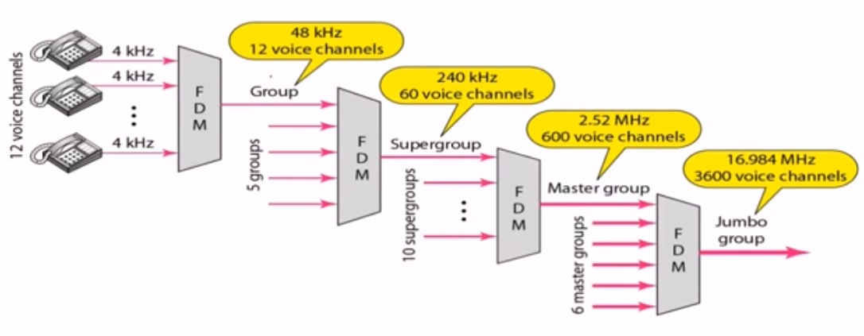
.

Slide 44
SYNCHRONOUS TIME DIVISION MULTIPLEXING
Multiplexor accepts input from devices in a round-robin fashion and transmit the data.
Synchronous TDM is called synchronous because the time slots are pre assigned to sources and fixed.
The slot length equals the transmitter buffer length, typically a bit or a byte (character).
The time slots for each source are transmitted whether or not the source has data to send
it is possible for a synchronous TDM device to handle sources of different data rates. For example, the slowest input device could be assigned one slot per cycle, while faster devices are assigned multiple slots per cycle
.

Slide 45
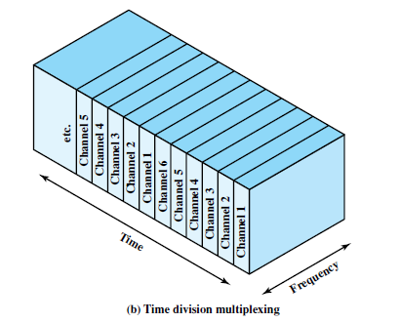
SYNCHRONOUS TIME DIVISION MULTIPLEXING
The multiplexer has six inputs that might each be, say, 9.6 kbps.
A single line with a capacity of at least 57.6 kbps (plus overhead capacity) could accommodate all six sources.
.

Slide 46
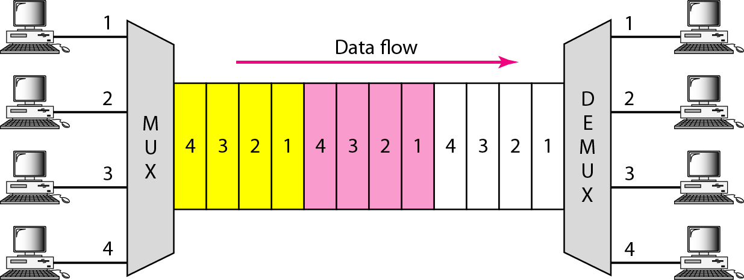
SYNCHRONOUS TIME DIVISION MULTIPLEXING
.

Slide 47
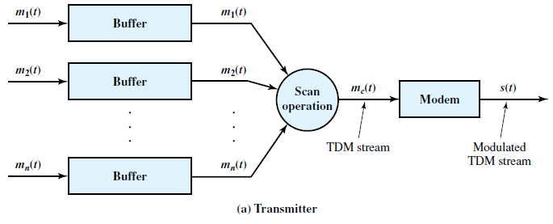
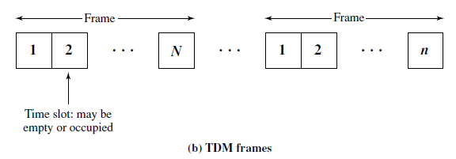
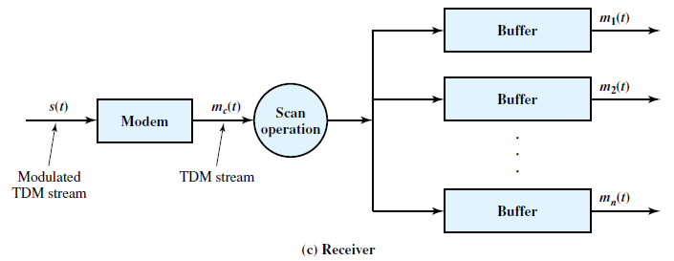
SYNCHRONOUS TIME DIVISION MULTIPLEXING
The data are organized into frames.
In each frame, one or more slots are dedicated to each data source.
The sequence of slots dedicated to one source, from frame to frame, is called a channel.
Figure 8.6 Synchronous TDM System
.

Slide 48
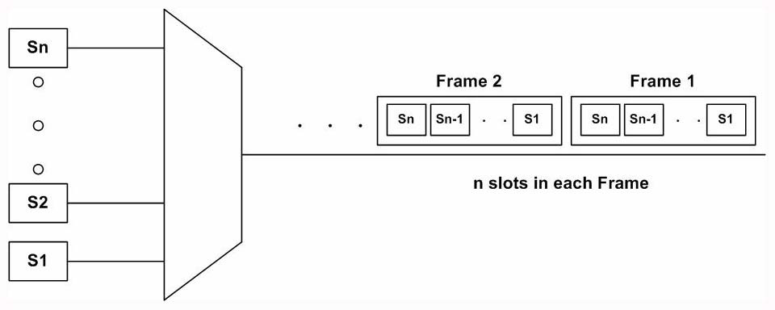
SYNCHRONOUS TIME DIVISION MULTIPLEXING
.

Slide 49
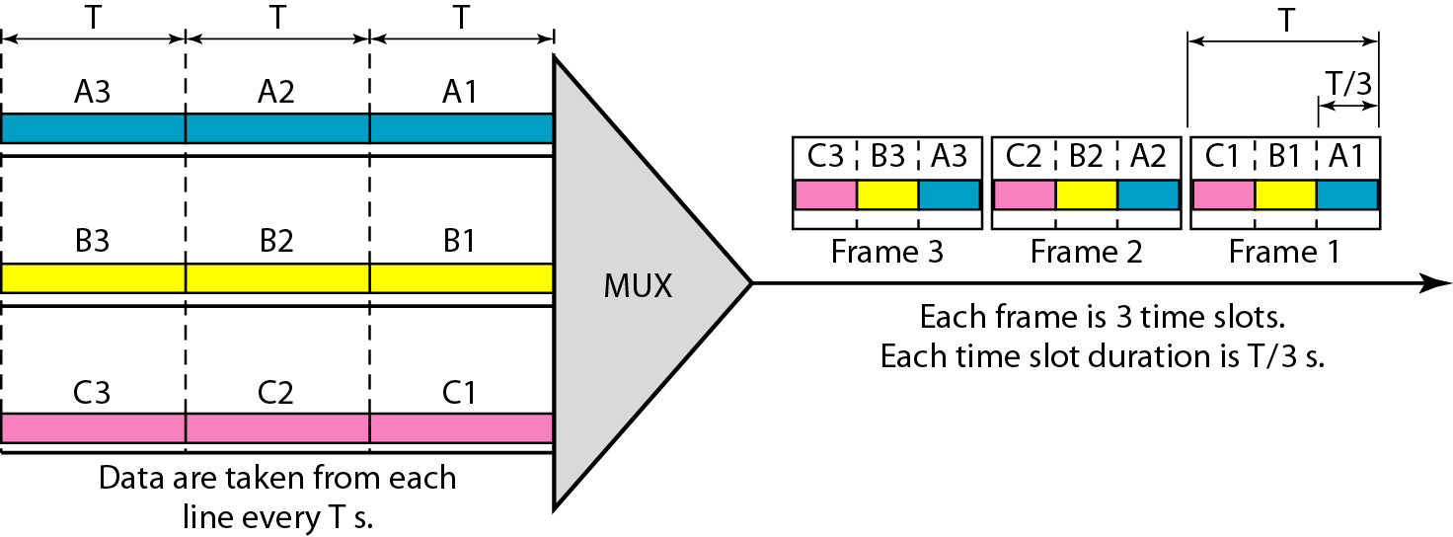
SYNCHRONOUS TIME DIVISION MULTIPLEXING
.

Slide 50
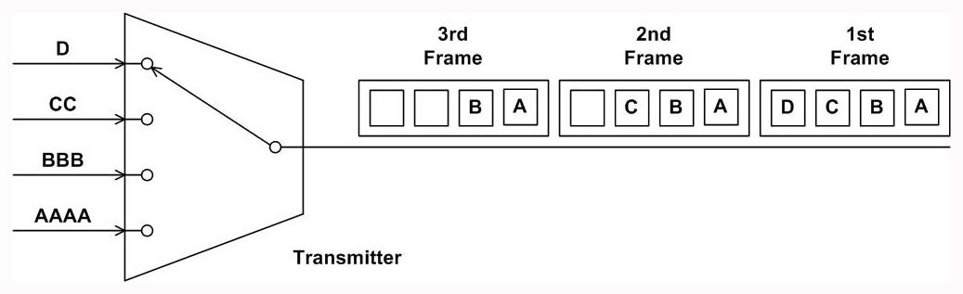
SYNCHRONOUS TIME DIVISION MULTIPLEXING
The time slots for each source are transmitted whether or not the source has data to send.
The capacity is wasted to achieve simplicity of implementation.
.

Slide 51
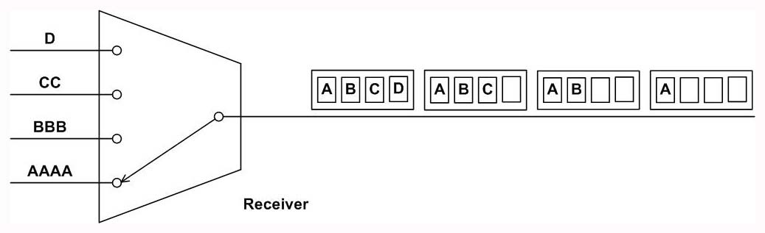
SYNCHRONOUS TIME DIVISION MULTIPLEXING
Even with fixed assignment it is possible for a synchronous TDM device to handle sources of different data rates.
For example, the slowest input device could be assigned one slot per cycle, while faster devices are assigned multiple slots per cycle.
.

Slide 52
STATISTICAL TIME DIVISION MULTIPLEXING
A statistical multiplexor transmits only the data from active workstations.
If a workstation is not active, no space is wasted on the multiplexed stream.
A statistical multiplexor accepts the incoming data streams and creates a frame containing only the data to be transmitted.
.

Slide 53
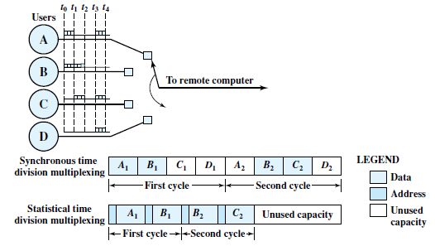
STATISTICAL TIME DIVISION MULTIPLEXING
Figure 8.12 contrasts statistical and synchronous TDM.
Figure 8.12 Synchronous TDM Compared with Statistical TDM
.

Slide 54
STATISTICAL TIME DIVISION MULTIPLEXING
The statistical multiplexer does not send empty slots if there are data to send.
However, the positional significance of the slots is lost.
Address information is required to assure proper delivery.
There is more overhead per slot for statistical TDM because each slot carries an address as well as data.
.

Slide 55
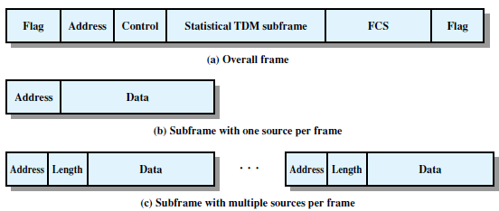
STATISTICAL TIME DIVISION MULTIPLEXING
Figure 8.13 shows two possible formats.
Figure 8.13 Statistical TDM Frame Formats
only one source of data is included per frame. That source is identified by an address.
The length of the data field is variable, and its end is marked by the end of the overall frame.
This scheme work well under light load but is quite inefficient under heavy load.
.

Slide 56
Transmission Media
.

Slide 57
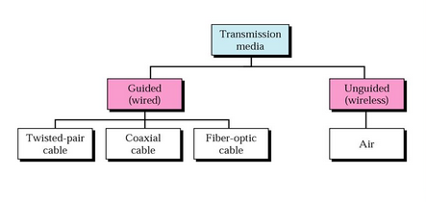
Transmission Media
Path between transmitter and receiver in a data communication system.
Guided Media: Waves are guided along the solid medium.
Unguided Media : Provides a means for transmitting electromagnetic signals through but do not guide them. Also called wireless transmission.
data rate depends on bandwidth, signal to noise ratio
.

Slide 58
Quality of transmission
Characteristics and quality of data transmission are determined by media and signal characteristics.
For Guided media, the medium is more important in determining the limitations of the transmission.
ie bandwidth, signal to noise ratio, attenuation.
For unguided media, the bandwidth of the signal produced by the transmission antenna is more important than the medium.
ie antenna will play a key role.
.

Slide 59
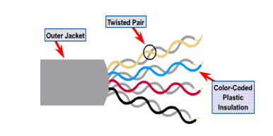
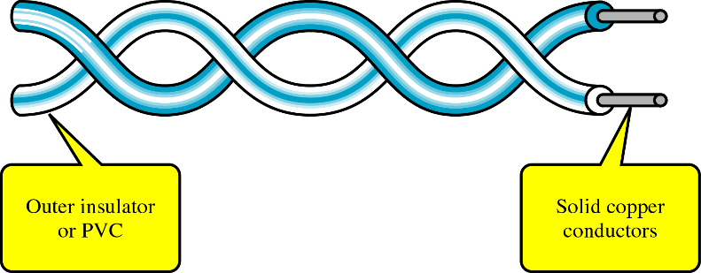
Twisted pair
Twisted pair consists of two insulated copper wires arranged in a regular spiral pattern.
Number of pairs are bundled together into a cable by wrapping them in a tough protective sheath.
.

Slide 60
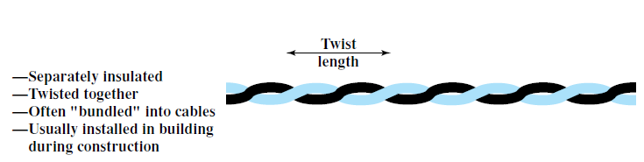
Why twisting
Signal passing in one pair of wire may induce signal on another pair of wire.
Twisting decreases the cross talk interference between adjacent pairs in a cable.
Tighter twisting produce much better performance, but also increases the cost.
Twisted Pair Categories
Category 3 : 3-4 twists per feet
Category 5 : 3-4 twists per inch
.

Slide 61
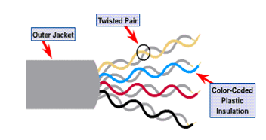
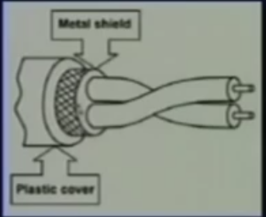
Twisted Pair common types
Unshielded Twisted Pair (UTP)
Ordinary telephone lines
Subject to electromagnetic interfernce. (spark, lightening)
Shielded Twisted Pair (STP)
Has a metal foil or braided mesh covering that encases each pair of insulated conductor.
Expensive compare to UTP
Not popular in our day to day applications like telephone, LAN etc
.

Slide 62
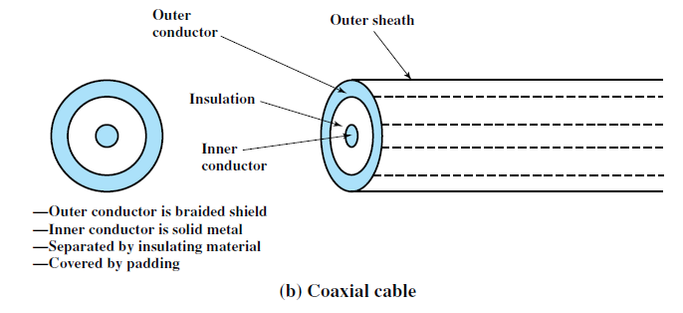
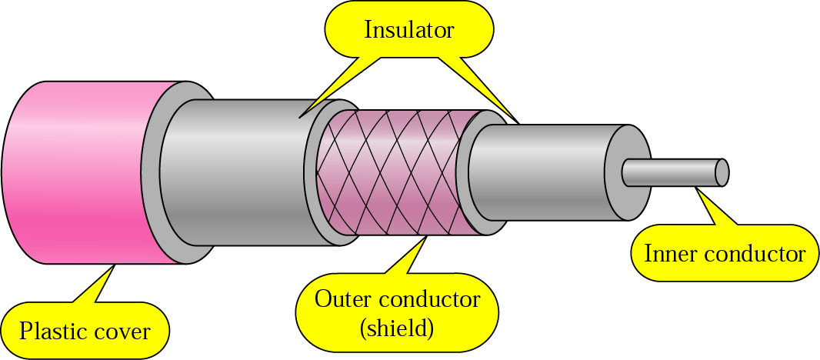
Coaxial cable
Consists of outer cylindrical conductor that surrounds a single inner wire conductor
The inner conductor is held in place by either regularly spaced insulating rings or a solid dielectric materials.
The outer conductor is covered with a jacket.
Due to its shielding, coaxial cables are much less susceptible to interference or crosstalk than twisted pair.
.

Slide 63
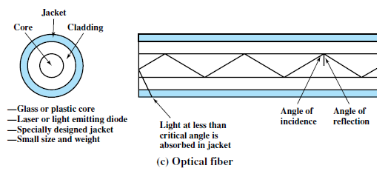
Optical fiber
A fiber-optic cable is made of glass or plastic and transmits signals in the form of light.
An optical fiber cable has a cylindrical shape and consists of three concentric sections: the core, the cladding, and the jacket .
.

Slide 64
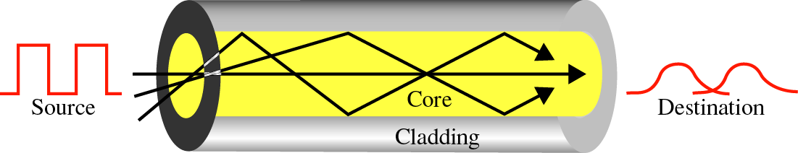
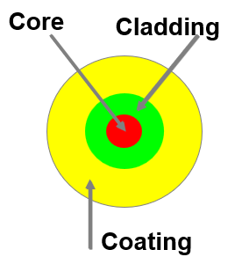
Optical Fiber
An optical fiber is made of three sections:
The core carries the light signals
The cladding keeps the light in the core
The coating protects the glass
Optical fiber transmits a signal-encoded beam of light by means of total internal reflection
Two different types of light source are used:
light emitting diode (LED) and
injection laser diode (ILD).
.

Slide 65
Characteristics of Optical Fiber
Greater capacity:
Data rate is high compared to twisted pair and coaxial cable.
Data rates of hundreds of Gbps over tens of kilometers.
Smaller size and lighter weight:
Thinner than coaxial cable or bundled twisted-pair cable
Lower attenuation:
Attenuation is lower for optical fiber than for coaxial cable or twisted pair.
Electromagnetic isolation:
Optical fiber systems are not affected by external electromagnetic fields.
Greater repeater spacing:
Fewer repeaters mean lower cost and fewer sources of error.
.

Slide 66
Wireless Transmission
Communication of data through the air without the use of physical conductors like cables or wires.
Uses electromagnetic waves such as radio waves, microwaves, and infrared waves to transmit signals over the air.
There are three major categories of wireless transmission:
Radio Waves : Used for long-distance communication like AM/FM radio, TV broadcasts, and mobile phones.
Microwaves : Used in satellite communication and point-to-point links such as microwave towers.
Infrared : Used in short-range communication like remote controls and wireless keyboards.
.

Slide 67
Wireless Transmission
Advantages:
Enables mobility and remote access.
Easy and fast deployment.
Useful in areas where wired infrastructure is impractical.
Disadvantages:
More prone to interference and signal degradation.
Security risks due to open transmission medium.
.

Slide 68
Antennas
Device used to transmit or receive electromagnetic waves.
Acts as a bridge between a wired communication system (like a transmitter or receiver) and the air through which wireless signals travel.
Types of Antennas:
Omnidirectional Antennas : Radiate signals in all directions (e.g., Wi-Fi routers).
Directional Antennas : Focus signals in a specific direction (e.g., satellite dishes).
Functions of an Antenna:
Converts electrical signals into electromagnetic waves during transmission.
Converts received electromagnetic waves into electrical signals during reception.
.

Slide 69
Wireless Propagation
A signal radiated from an antenna travels along one of three routes:
Ground wave,
Sky wave,
Line of sight (LOS).
.
.

Slide 70
Tutorial 2
.

Slide 71
Example
We need to use synchronous TDM and combine 20 digital sources, each of 100 Kbps. Each output slot carries 2 bit from each digital source, but one extra bit is added to each frame for synchronization. Answer the following questions:
a. What is the size of an output frame in bits?
b. What is the output frame rate?
c. What is the duration of an output frame?
d. What is the output data rate?
e. What is the efficiency of the system (ratio of useful bits to the total bits).

Slide 72
Each output frame carries 2 bits from each source plus one extra bit for synchronization.
Frame size = 20 × 2 + 1 = 41 bits.
Each frame carries 2 bit from each source. Frame rate = 100,000/2 = 50,000 frames/s.
Frame duration = 1 /(frame rate) = 1 /50,000 = 20 μs.
Data rate = (50,000 frames/s) × (41 bits/frame) = 2.05 Mbps.
In each frame 40 bits out of 41 are useful. Efficiency = 40/41= 97.5%.

Slide 73
Example
Ten sources, six with a bit rate of 200 kbps and four with a bit rate of 400 kbps are to be combined using TDM with no synchronizing bits. Answer the following questions about the final stage of the multiplexing:
What is the size of a frame in bits?
What is the frame rate?
What is the duration of a frame?
What is the data rate?
[Each output slot carries 1 bit from each digital source]

Slide 74
We combine six 200-kbps sources into three 400-kbps. Now we have seven 400-kbps channel.
Each output frame carries 1 bit from each of the seven 400-kbps line. Frame size = 7 × 1 = 7 bits.
Each frame carries 1 bit from each 400-kbps source. Frame rate = 400,000 frames/s.
Frame duration = 1 /(frame rate) = 1 /400,000 = 2.5 μs.
Output data rate = (400,000 frames/s) × (7 bits/frame) = 2.8 Mbps. We can also calculate the output data rate as the sum of input data rate because there is no synchronizing bits. Output data rate = 6 × 200 + 4 × 400 = 2.8 Mbps.

Slide 75
Example
Show the contents of the five output frames for a synchronous TDM multiplexer that combines four sources sending the following characters. Note that the characters are sent in the same order that they are typed. The third source is silent.
Source 1 message: HELLO
Source 2 message: HI
Source 3 message:
Source 4 message: BYE

Slide 76
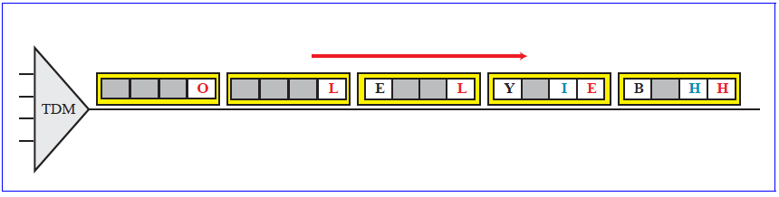

Slide 77
Example
A character-interleaved time division multiplexer is used to combine the data streams of a number of 110-bps asynchronous terminals for data transmission over a 2400-bps digital line. Each terminal sends asynchronous characters consisting of 7 data bits, 1 parity bit, 1 start bit, and 2 stop bits. At least 3% of the line capacity is reserved for pulse stuffing to accommodate speed variations from the various terminals.
Determine the number of bits per character.
Determine the number of terminals that can be accommodated by the multiplexer.

Slide 78
n = 7 + 1 + 1 + 2 = 11 bits/character
Available capacity = 2400 × 0.97 = 2328 bps
If we use 20 terminals sending one character at a time in TDM, the total capacity used is:
20x110 bps=220bps<2328
21 × 110 bps = 2310 bps available capacity
22 x 110bps=2420>2328

